Slide 1
PTP profile for FTI
Øyvind Holmeide/Markus Schmitz
by
01/13/2016

Slide 2
PTP profile for FTI
Main PTP properties that are relevant for a PTP profile for FTI:
PTP versions
Clock modes
One-step vs. two step clocks
Media
Delay mechanism
Transport mechanism
Domain
Selection of Best Master Clock
PTP EPOCH
Sync interval
Delay_Req interval
Announce interval
PPS output
IRIG-B 002/122
Management
SNMP traps
GMC holdover
SC accuracy
SC time to synchronization

Slide 3
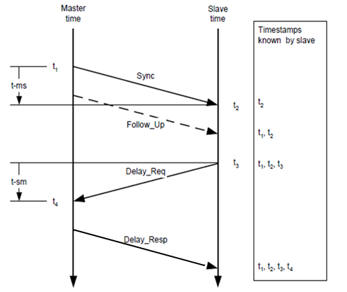
PTP profile for FTI
PTP versions
Version 1 according to IEEE 1588™ - 2002
Version 2 according to IEEE 1588™ - 2008
(Version 3: NA, except for systems with sub-nanosecond requirements)
Clock modes
Grand Master Clock (GMC)
Ordinary Clock (OC)
(Boundary Clock (BC))
Transparent Clock (TC)
Slave Clock (SC) only
One-step vs. two step clocks
Only two-step

Slide 4
PTP profile for FTI
Media
Ethernet
10/100BASE-T(X), 100BASE-FX, ), 1000BASE-X and 10GBASE-X, etc
Full Duplex
Delay mechanism
E2E
Transport mechanism
PTP over UDP/IP
Multicast with destination IP address: 224.0.1.129
UDP destination port number 319 (event packets) and 320 (general packets)

Slide 5
PTP profile for FTI
Domain
Default domain (0)
Selection of Best Master Clock
Default BMCA (mandatory)
PTP EPOCH
TAI

Slide 6
PTP profile for FTI
Sync interval
[1, 2] seconds for IEEE 1588™ - 2002, where:
1 second is default Sync interval for IEEE 1588™ - 2002
[0.125 .. 2] seconds for IEEE 1588™ - 2008, where:
0.125ms is default Sync interval for IEEE 1588™ - 2008
Delay_Req interval
60 seconds with randomization for IEEE 1588™ - 2002
[Sync interval, 32 x Sync_interval] seconds with randomization for IEEE 1588™ - 2008
Announce interval
1588™ - 2002: NA
1588™ - 2008: 2 x Sync interval

Slide 7
PTP profile for FTI
PPS output
Mandatory for;
GMC
OC
(BC)
TC/SC
SC
IRIG-B 002/122
Mandatory for;
GMC
OC
Optional for;
TC/SC
SC

Slide 8
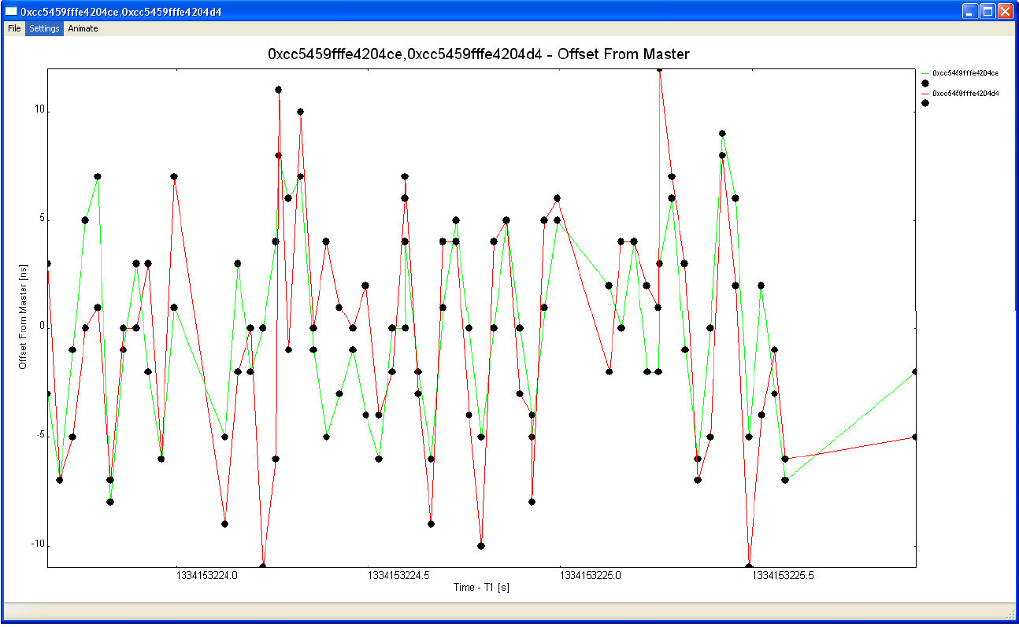
PTP profile for FTI
Management
Mandatory:
iNET SNMP and MDL
Optional:
PTP management according to chapter 15 of IEEE 1588™ - 2008
Private MIB or MIB based on PTP version 3?
PTP management
based on
PTPv2Browser,
monitoring
OffsetFromMaster

Slide 9
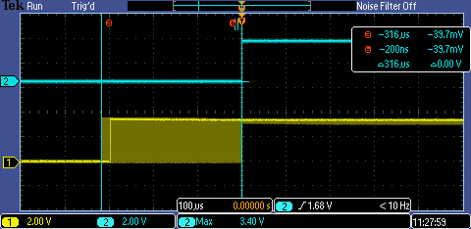
PTP profile for FTI
SNMP traps
iNET SNMP traps, ref TmNS MIB:
timeLockLostNotificationBranch
ieee1588MaxOffsetFromMasterNotificationBranch
ieee1588MaxJitterNotificationBranch
GMC holdover
0.1ppm (iNET requirement)
CM1608F0-AERO-GMC, clock drift over 60 minutes with temperature cycling: -40˚F/-40˚C to 203˚F/95˚C

Slide 10
PTP profile for FTI
SC accuracy
1ppm (iNET requirement)
SC time to synchronization
1 seconds for airborne systems (iNET requirement)
3 seconds for ground installations (iNET requirement)

Slide 11
PTP profile for FTI
 | IEEE 1588™ - 2002 FTI PTP profile | IEEE 1588™ - 2008 FTI PTP profile
Clock modes | OC (GMC), TC(*), Slave only | OC (GMC), TC, Slave only
One-step or two step clocks | Two-step | Two-step
Media | Ethernet, full duplex according to IEEE802.3 | Ethernet, full duplex according to IEEE802.3
Delay mechanism | E2E | E2E
Transport mechanism | PTP above UDP/IP, multicast with destination IP address: 224.0.1.129 and UDP destination port number 319 (event packets) and 320 (general packets) | PTP above UDP/IP, multicast with destination IP address: 224.0.1.129 and UDP destination port number 319 (event packets) and 320 (general packets)
Domain | Only default domain (0x00) is used | Only default domain (0x00) is used
Selection of Best Master Clock | Default BMCA algorithm | Default BMCA algorithm
PTP EPOCH | Time representation based in TAI, offset to UTC time (accumulated number of leap seconds) is defined in the currentUTCOffset parameter. | Time representation based in TAI, offset to UTC time (accumulated number of leap seconds) is defined in the currentUTCOffset parameter.
Sync interval | [1, 2]s, default = 1s | [0.125 .. 2]s, default = 0.125s
Delat_req interval | 60s, randomized | [Sync interval .. 32]s, default = 32s, randomized; controlled by GMC
Announce interval | NA | [1, 2, 4, 8, 16]s, default = 2s
PPS output | Mandatory | Mandatory
IRIG-B 002/122 | Mandatory for GMC Optional for TC/SC | Mandatory for GMC Optional for TC/SC
Management | iNET SNMP/MDL | iNET SNMP/MDL Optional: PTP management according to IEEE 1588™ - 2008
SNMP traps | iNET MIB | iNET MIB
GMC holdover | 0.1ppm, iNET requirement | 0.1ppm, iNET requirement
SC accuracy | 1ppm, iNET requirement | 1ppm, iNET requirement
SC time to synchronization | 1s/3s (airborne/ground), iNET requirement | 1s/3s (airborne/ground), iNET requirement

Slide 12
Questions?

